Slide 1

Bank Loan of Customers
Presented by GROUP - I

Slide 2

Team Members
Ratnam V Mohan Kumar
Prashant Jaysing Bhosale
Suraj Narayan Katkar
Shaikh Mazhar Altaf

Slide 3

INTRODUCTION
The goal of this project is to uncover important insights about loan issuance trends, customer credit behavior, and financial performance metrics through an in-depth analysis of bank loan data.
The analysis combines Excel, Power BI, Tableau, and SQL for data extraction and transformation into data visualization, providing a comprehensive overview of loan trends over time, the financial health of different customer segments, and risk assessment across various loan grades.
The purpose of this study is to examine various parameters such as loan amounts, repayment rates, customer demographics, credit history, and other factors that influence lending decisions through the use of datasets.
The project aims to uncover insights that can help banks improve their decision-making processes, minimize risks, and enhance customer satisfaction by utilizing statistical methods and visualization tools.

Slide 4

Data Cleaning
Our analysis, cleaning, and removal of duplicates from the dataset were accomplished using MS Excel, MySQL, and Tableau tools, along with preparing interactive dashboards using Tableau and PowerBI tools that involved calculations and mergers.
Removing Redundant
Desc, pymnt_plan, title, emp_title removed as those are redundant columns.
Data types
‘Issue_d’ Column in finance_1 sheet was changes to ‘dd-mm-yyyy’.
Null Values
Removed more null values columns like emp_title and pymnt_plan.

Slide 5

KPI’S for Analysis
Year-wise loan amount Stats
Grade and sub-grade-wise revolving balance
Total Payment for Verified Vs Non-Verified Status
State-wise and month-wise loan status
Home ownership Vs last payment date stats

Slide 6

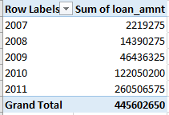
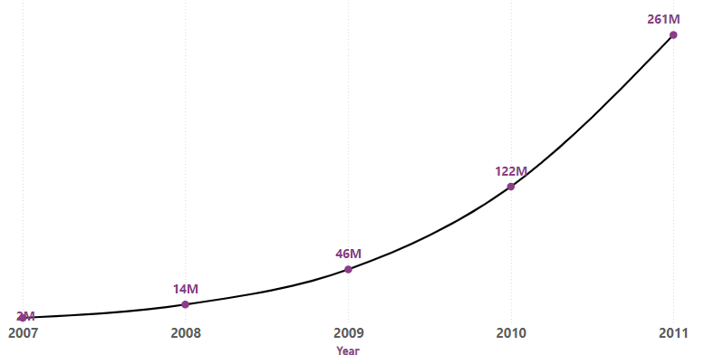
Year-wise loan amount Stats
According to the chart, there was a significant increase in the total amount of loans issued from 2007 to 2011.
A noticeable increase in loan amounts occurred from 2007 to 2009. Between 2010 and 2011, the total loan amount doubles, making it the most dramatic growth.

Slide 7

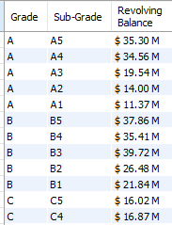
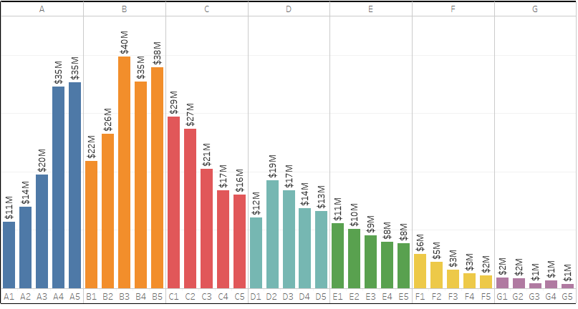
Grade and sub-grade-wise Revol-Bal
According to the chart, Grade A and Grade B have the highest revolving balances compared to other grades.
The A4 and A5 sub-grades are the top-ranked in Grade A. On the other hand, B3, B4, and B5 are the top-ranked in Grade B.
The revolving balances for Grade F and G are the lowest in their respective grades, while F5 and G5 are the lowest in their respective grades.

Slide 8

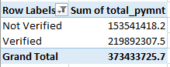
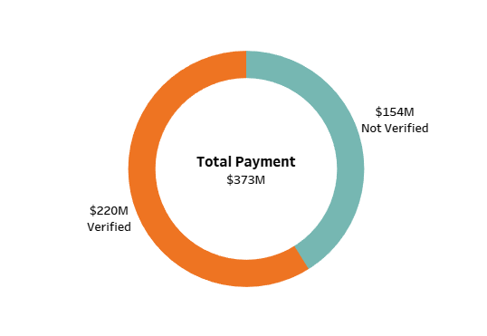
Total Payment for Verified Vs Non-Verified Status
This is the initial stage of the verification process. The bank requires a loan application to begin collecting and verifying documents.
The pie chart shows that the verified status accounts for 58.88% of the total payment, while 41.12% of the loan amount is not verified.
The fact that over half of the total population or dataset has been verified indicates a higher overall verification rate. Although the majority of the percentage is verified, over 40% is still not verified, which indicates that there is room for improvement in the verification process.

Slide 9

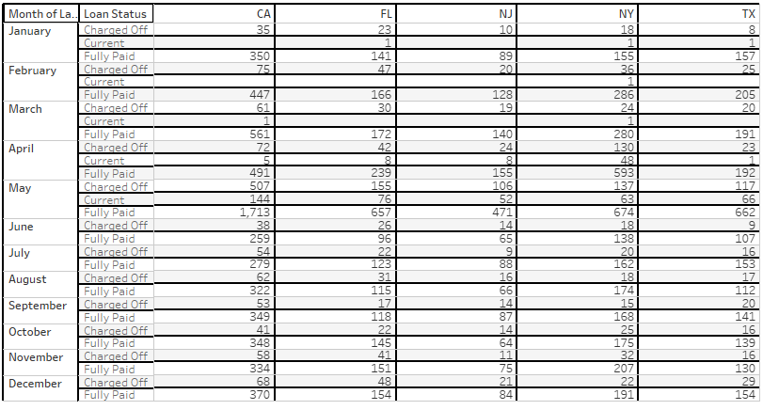
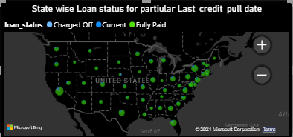
State-wise and month-wise loan status
The table showcases all fully paid loans across 10 states, and it is evident that 97% of bank customers have a fully paid status in each state.
California holds the highest rank, followed by New York and Florida. The maximum number of customers who took loans has been given by CA, which is over 5000. The picture further analyzes California for the month-wise fully paid amount status, showing us the quantitative loan amount.
The count of loans in each state of the USA is displayed on a specific last credit pull date. The amount of fully paid loans in California was the highest in December.

Slide 10

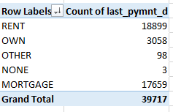
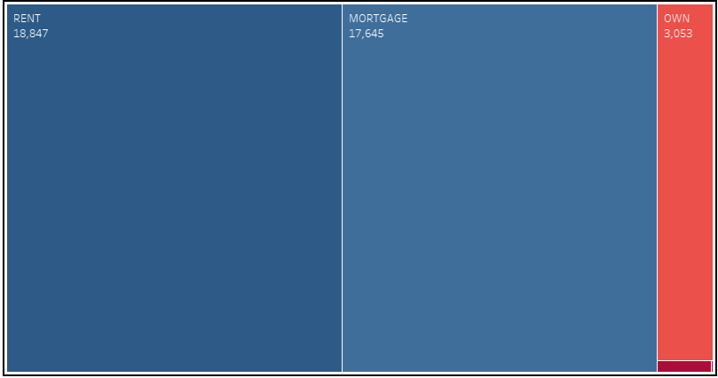
Homeownership Vs last payment date stats
The table displays the ownership and payment amounts for each on the last payment date. The most common type of accommodation for individuals is renting, with 18,899. The latest maximum amount paid by customers is shown here.
Among all groups, mortgage holders are the second largest with 17,659. The combination of mortgage and ownership categories reveals that 20,717 individuals possess some form of home ownership. The fact that there are so many mortgages indicates that a large portion of the population has long-term financial obligations related to housing.
The conclusion is that many customers are currently in the process of repaying their loans for their specific home ownership.

Slide 11
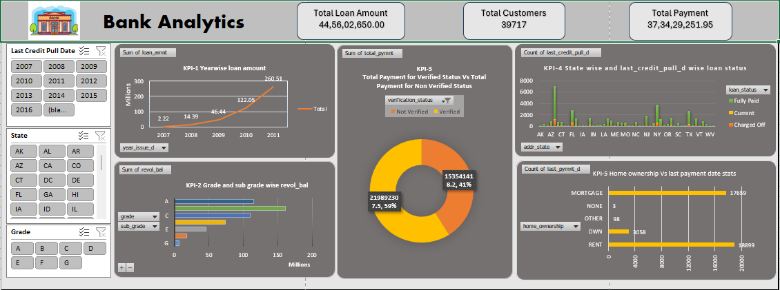
Excel Dashboard

Slide 12
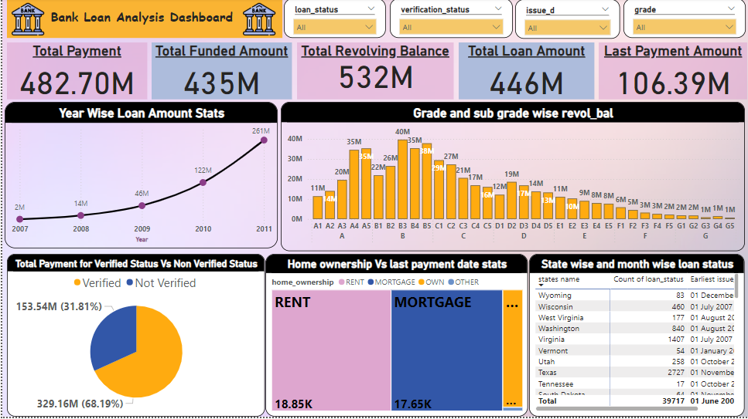
Power-BI Dashboard

Slide 13
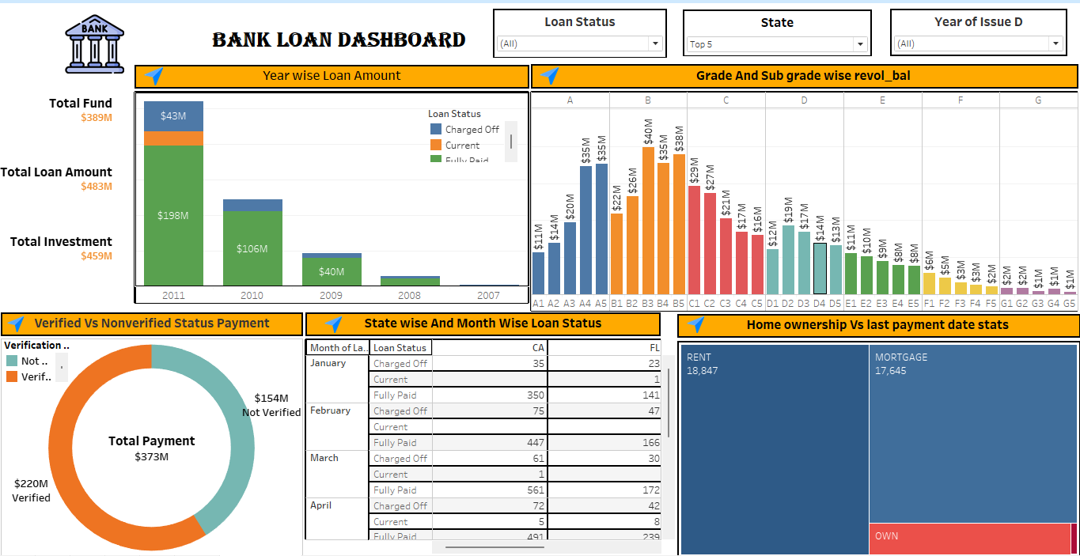
Tableau Dashboard

Slide 14
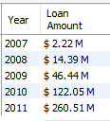
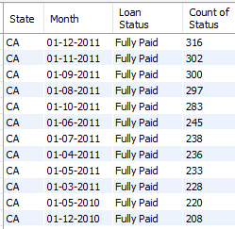
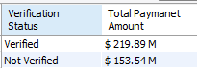
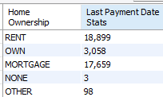
MY SQL

Slide 15

Conclusion
Loans are granted to companies, individuals, and industrial concerns to provide benefits. The bank's most significant assets and primary sources of income are loans and advances.
Bank management should always try to make an appropriate balance between return and risk involved with the loan portfolio, and an unregulated bank might be with unregulated risk for maximizing its potential return.
To provide the best service to their clients, the Credit Division must have qualified and dedicated employees. The credit department spreads its loans across various sectors. The bank's lending rates are lower in the agricultural sector compared to other sectors. This sector is highly risky and influenced by the natural climate, as demonstrated by the reason.
The bank is not giving more loans to the small and cottage industry. This sector's return is not very good and is also very uncertain, which is the reason. The bank mainly provides credit for term loans, with a focus on long-term loans. Short-term loans offer a high return and are also a safe way to finance.
Bank should concentrate on Major-purchase as there is no out result from this sector.

Slide 16

Thank you

